Slide 1
MS Excel Applications
REKHA
ER/CORP/

Slide 2
Overview of MS Excel (1/2)
  What is a Spread Sheet?
  A Spread Sheet is a computer Application which contains worksheet with the matrix of rows & columns. Spread sheet is used to,
  Perform detailed analysis of numeric data.
  Define formulas to perform calculations on the given data.
  Link spreadsheets & representing in the form of graph.
  Recalculate the data.
Examples : Lotus 1-2-3, MS Excel
  A workbook is made up of Cells.
  A single worksheet consists of 10,48,576 rows and 16,384 columns

Slide 3
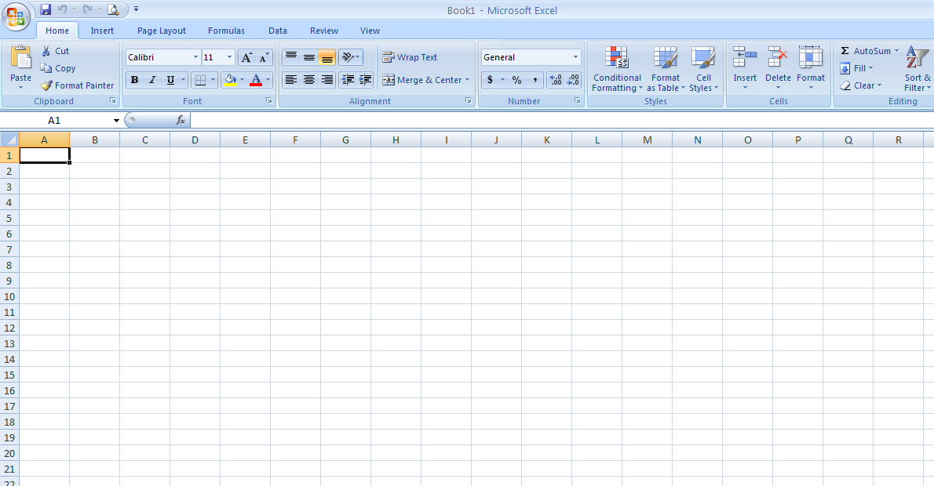
Overview of MS Excel (2/2)
Name Box
Formula bar
Cell
Rows
Columns

Slide 4
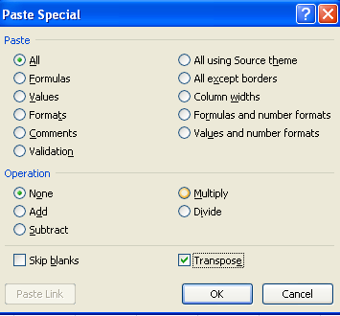
Data Editing (1/3)
Rows & Columns
  Adding and Deleting Rows / columns
    =Row() → returns the row no. of the reference cell
    =Column() → returns the column no. of the reference cell
Copy, Cut and paste
Paste Special
  Link, Transpose, Value and Format

Slide 5
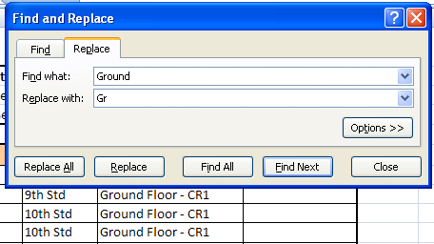
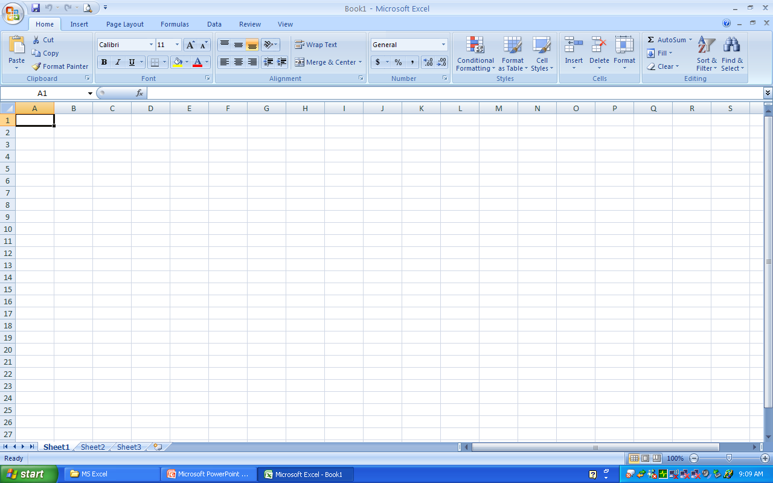
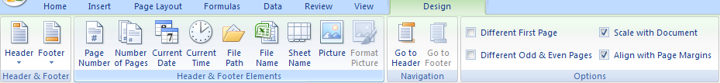
Data Editing (2/3)
Find & Replace
  Finding the contents within a sheet / within a workbook
  Finding the format and replacing the cell content
Header & Footer
  Inserting Page no & No. of pages
  Inserting File name, Time etc

Slide 6
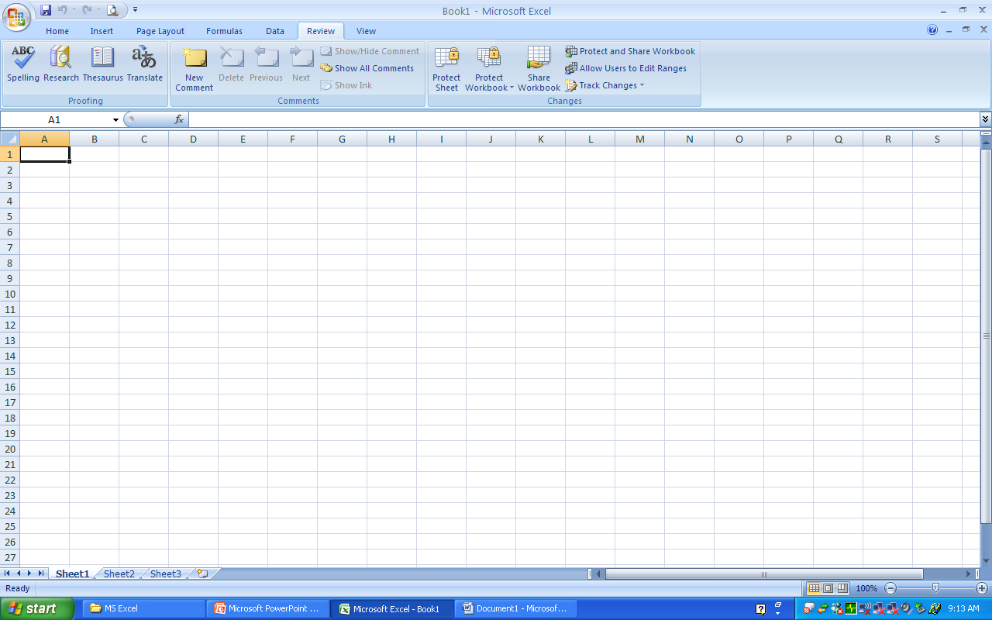
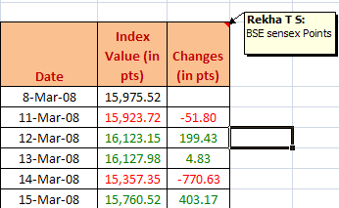
Data Editing (3/3)
Inserting, Editing & Deleting comments

Slide 7
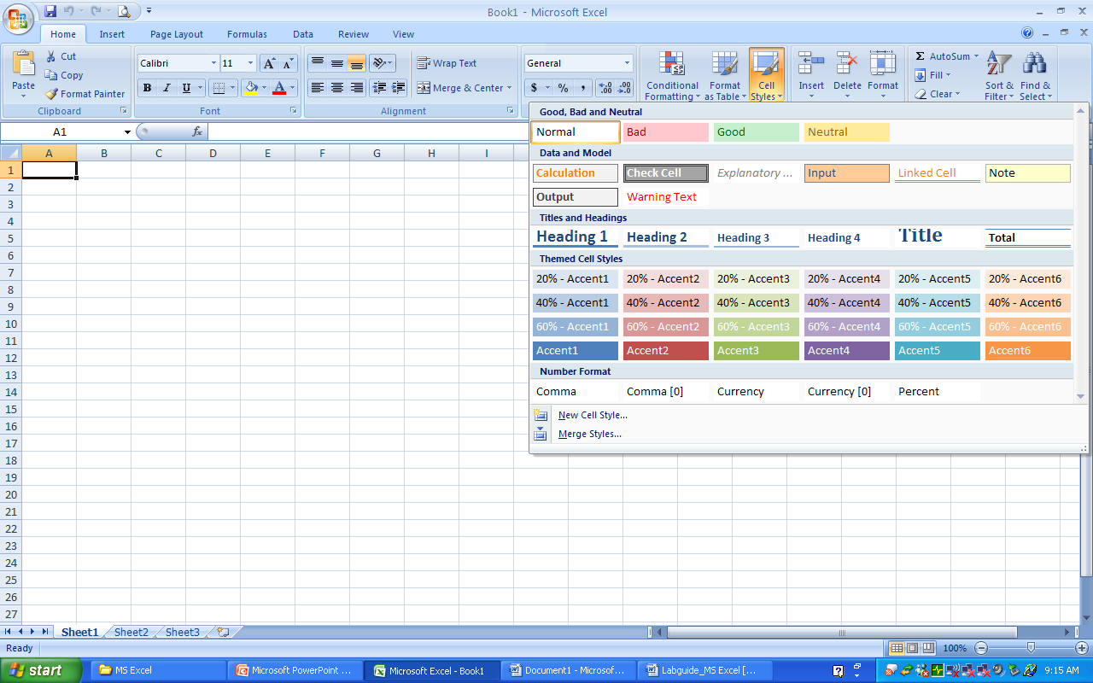
Data Formatting (1/4)
Font Style & Color
  Font Color and background color
Auto Format
  A built in collection of cell formats such as font size, patterns & alignment that you can apply to a range of data. Excel determines the levels of summary and detail in the selected range and applies the format accordingly.

Slide 8
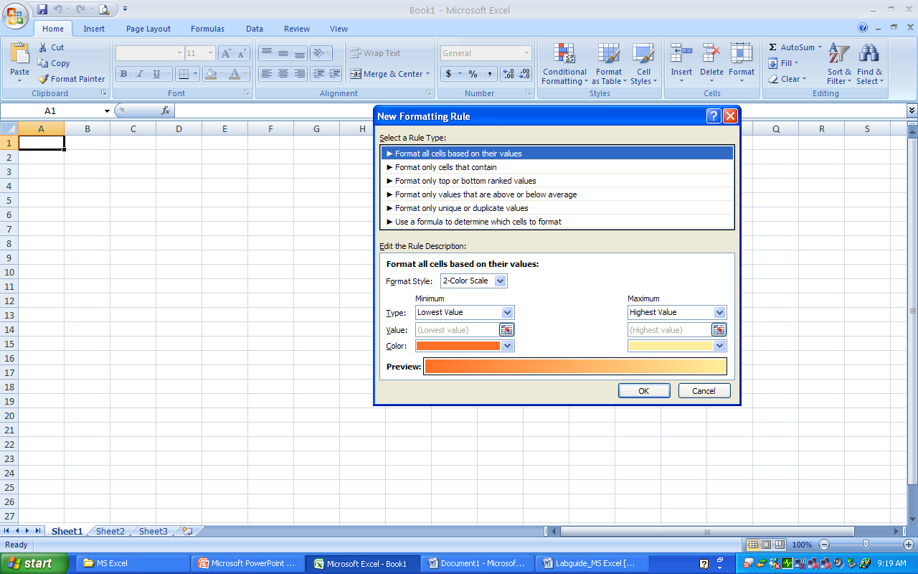
Data Formatting (2/4)
Conditional Formatting
  Creating new rules
  Managing the existing rules

Slide 9
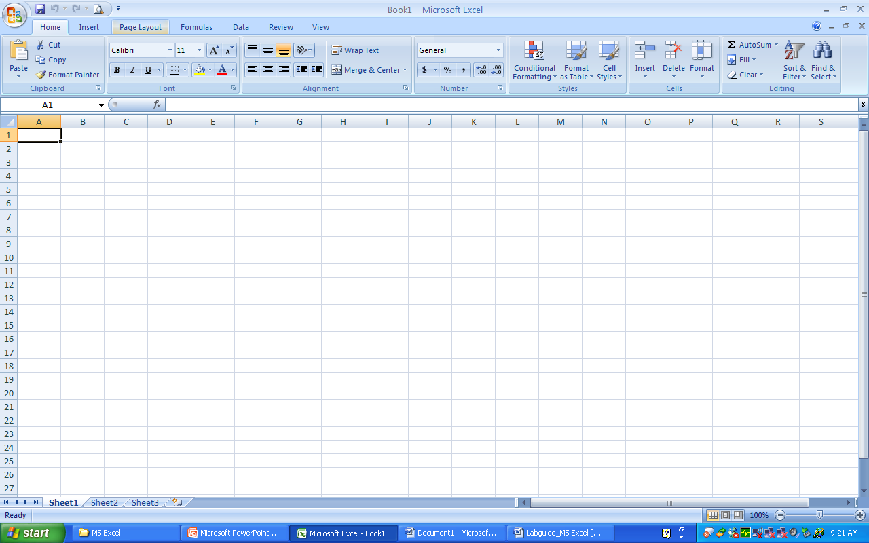
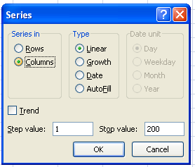
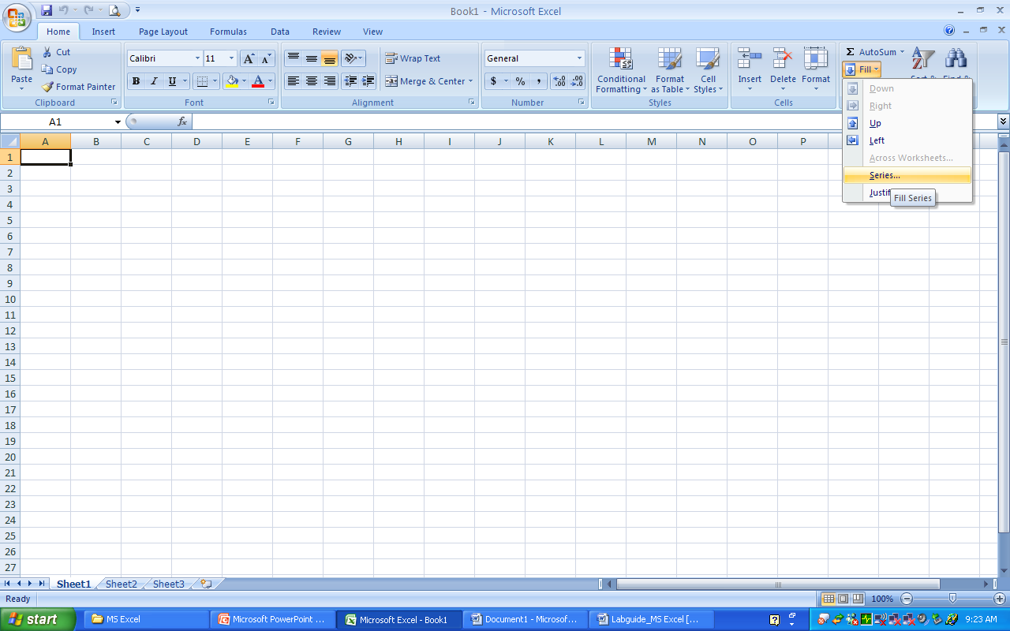
Data Formatting(3/4)
  Format Painter
  Fill Series
Notes:
Style
Create a new style
Format Painter
To apply the format to the destination cells
Fill Series

Slide 10
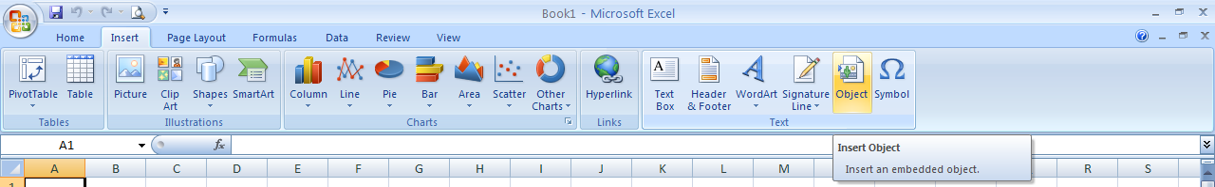
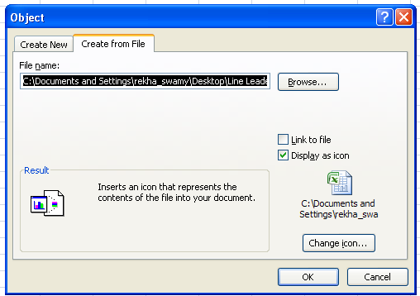
Data Formatting (4/4)
Inserting an Object
    Creating a link to the file
    Displaying the object as an icon

Slide 11
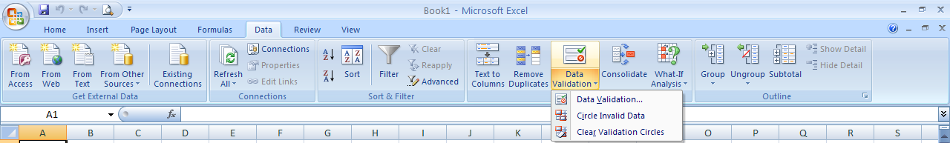
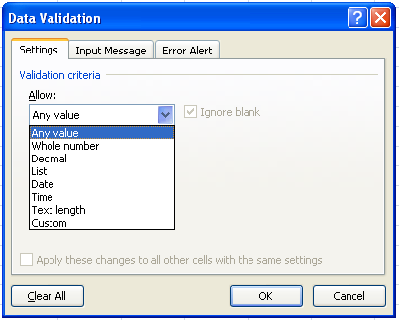
Data Tools (1/3)
Data Validation
    Allow Values from the list
    Allow numbers within limits
    Allow dates or times within a time frame
    Allow the text of a specified length

Slide 12
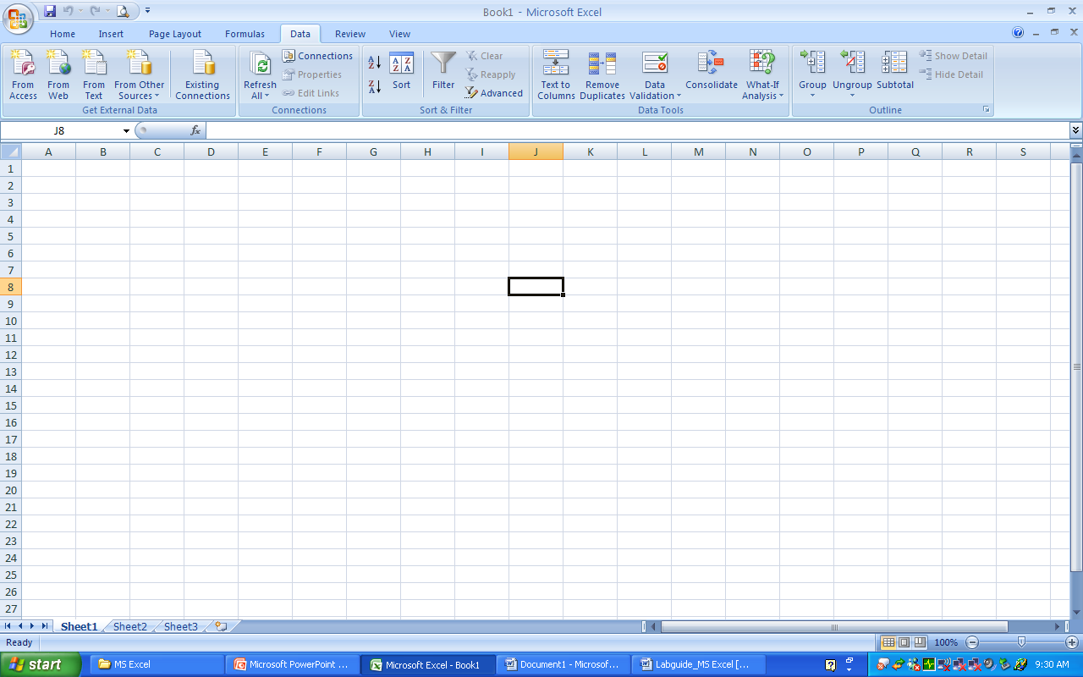
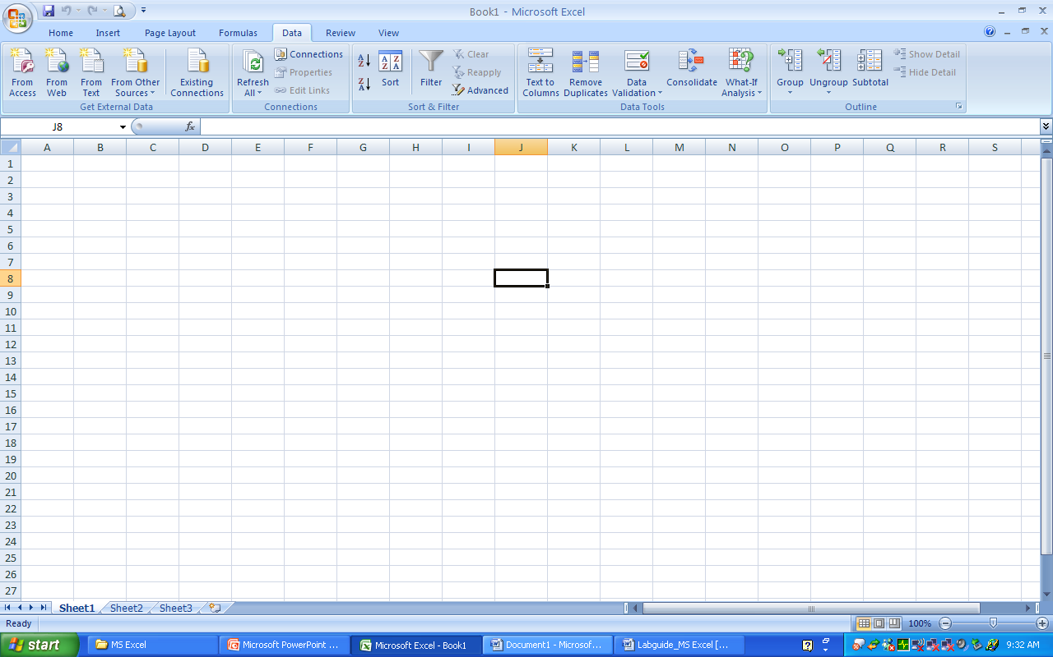
Data Tools (2/3)
Auto Filter & Advanced Filter
  When you apply a filter to a column, the only filters available for other columns are the values visible in the currently filtered list
Sorting Options
  Customer Sort by adding levels

Slide 13
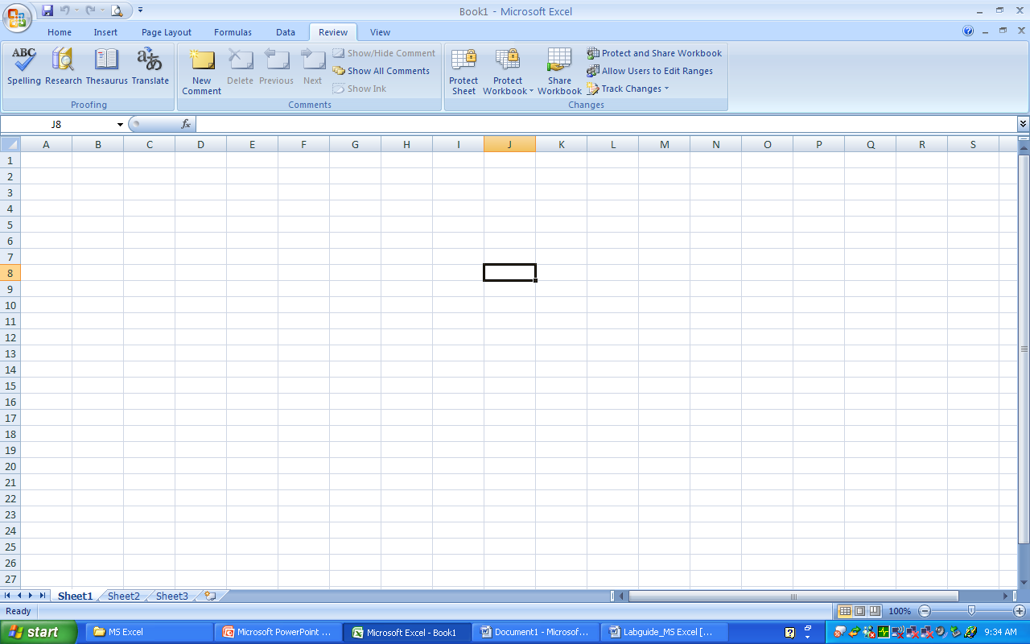
Data Tools (3/3)
Protecting the Sheets & Workbook
    When you protect a sheet or worksheet, you can protect or unprotect individual elements of the sheet in the protect sheet dialogue box
    Sheets/ Work can be project with or without Password

Slide 14
Functions & Formulae - Date & Time Functions
=Now() → returns today’s date & time
= Today() → returns today’s date
= Networkdays() → returns the no. of working dates between two days
    Argument includes,
    Start_Date: Is a day that represents the start date
    End_Date: is a date that represents the end date
    Holidays: is an optional range of one or more dates to exclude from the working calendar.

Slide 15
Functions & Formulae - Statistical Functions (1/2)
=Count() → Counts the values within the parenthesis
  Argument includes,
  =count(Vaule1,value2…..)
=Average() → returns average (arithmetic mean) of the argument
  Argument includes,
  =Average(Number1,Number2…..)
= Averageif() → returns the average (arithmetic mean) of all the cells in a range that meet a given criteria.
  Argument includes,
  =Averageif(range,criteria,[average_range]))

Slide 16
Functions & Formulae – Statistical Functions (2/2)
Countif() → Counts the no. of nonblank cells with the given criteria
    Argument includes,
    =Countif(Range,Criteria)
Emp No | Band | Salary | COUNTIF(K4:K9,"B")
1000 | B | 15000 | Returns-> | 3
1001 | C | 18000
1002 | D | 20000 | COUNTIF(K4:K9,"C")
1003 | B | 15000 | Returns-> | 2
1004 | C | 18000
1005 | B | 15000

Slide 17
Functions & Formulae - Logical Functions (1/2)
=if() & Else → Specifies the logical test to be performed & returns the logical value
    Argument includes,
    IF(logical_test,value_if_true,value_if_false)
    Eg1., =if(55>45,”Correct”,”Wrong”) – Returns Correct
    Eg2. - more than one if condition,
    Returns AP
    Eg3., nested If
CGPA | TP/ HP / AP
4.42 | IF(A1>=4.95,"TP",IF(A1>=4.5,"HP","AP"))
Emp No. | Yrs of Experience | CRR | Role Play | Role Change |  | Criteria for Role change
1000 | 4 | 1 | GPM | Not Eligible |  | a | Years of expr >=2
1001 | 1 | 2 | PM | Not Eligible |  | b | CRR =1
1002 | 4 | 2 | GPM | Not Eligible |  | c | Role Play = PM
1003 | 5 | 1 | PM | Eligible
IF(C7>=2,IF(D7<2,IF(E7="PM","Eligible","Not Eligible"),"Not Eligible"),"Not Eligible")

Slide 18
Functions & Formulae – Logical Functions (2/2)
And () → returns TRUE if all the arguments are true
    Argument includes,
    =And(logical1,logical2 ….)
Not () → returns TRUE if all the arguments are false
    Argument includes,
    =Not(logical)
OR () → returns TRUE if one of the argument is true
    Argument includes,
    =OR(logical1,logical2 …)

Slide 19
Functions & Formulae – Text based Functions (1/2)
Len() – returns the length of a specific text
Mid() – returns a specific number of characters
    Argument includes,
    =mid(text,start_num,Number_chars)
Emp No | Batch Name
73914 | 2006 Oct LC1 PED | 2006 Oct | MID(B4,1,8)
74099 | 2006 Oct LC1 PED | 2006 Oct
74140 | 2006 DEC LC1 CHD | 2006 DEC
74258 | 2006 DEC LC1 CHD | 2006 DEC

Slide 20
Functions & Formulae – Text based Functions (2/2)
Concatenate() – Joins several text strings into one string
  Argument includes
    =concatenate(text1,text2….)
    =(“text1”&”text2”)
Exact() → returns TRUE if there is an exact match
  Argument includes
  =Exact(text1,text2)
Trim() → removes the extra spaces in a text
    Argument includes
=Trim(text)

Slide 21
Functions & Formulae – Mathematical Functions (1/2)
Abs() → returns the absolute value of a number.
    Argument includes,
    =Abs(number)
Round() → rounds the no. to the specified number of digits
    Argument includes,
    =Round(245.2367,2) – Returns 245.24
    =Round(245.3456,0) – Returns 245

Slide 22
Functions & Formulae – Mathematical Functions (2/2)
Sum() → Adds all the numbers in a range of cells
  Argument includes,
  =Average(Number1,Number2…..)
Sumif() → Adds the cells specified by the given criteria
Emp No | Band | Salary |  | SUMIF(C4:C13,"B",D4:D13)
1000 | B | 15000 |  | Returns-> | 45000
1001 | C | 18000
1002 | D | 20000 |  | SUMIF(C4:C9,"C",D4:D9)
1003 | B | 15000 |  | Returns-> | 36000
1004 | C | 18000
1005 | B | 15000

Slide 23
Vlookup / Hlookup
The VLOOKUP function’s arguments are as follows:
lookup_value: The value to be looked up in the first column of the lookup table.
table_array: The range that contains the lookup table.
col_index_num: The column number within the table from which the matching value is returned.
range_lookup: Optional. If TRUE or omitted, an approximate match is returned. (If an exact match is not found, the next largest value that is less than lookup_value is returned.) If FALSE, VLOOKUP will search for an exact match. If VLOOKUP cannot find an exact match, the function returns #N/A.

Slide 24
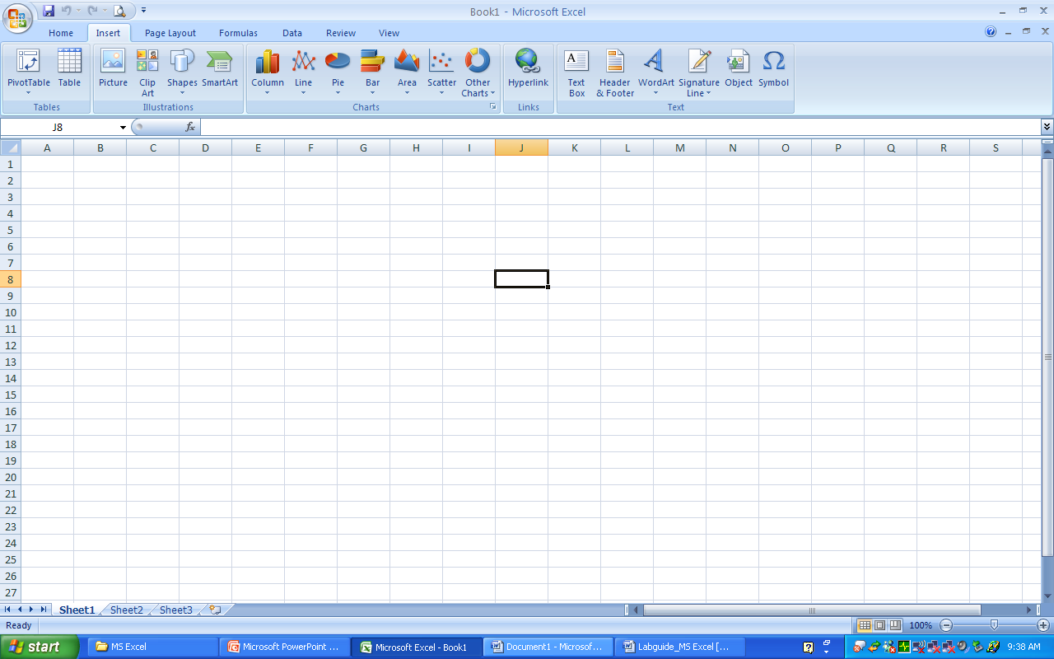
Charts & Graphs (1/6)
Microsoft Excel supports numerous types of charts to help you display data in ways that are meaningful to your audience. When you want to create a chart or change an existing chart, you can choose from a wide range of chart subtypes available

Slide 25
Charts & Graphs (2/6)
Data : Atleast two sets of data, one to represent the X axis and the other to represent the Y axis
Axis Labels : Assign labels to the X axis and Y axis
Legend : Identifies a set of data - if there are more than one set of data on the same axis
Data Labels : required to display numerical value of a bar chart or section chart
Can be either embedded on the same sheet or on a different sheet

Slide 26
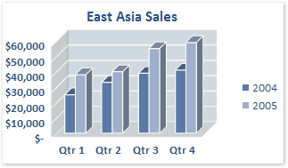
Charts & Graphs (3/6)
Column charts
Column charts are useful for showing data changes over a period of time or for illustrating comparisons among items.
In column charts, categories are typically organized along the horizontal axis and values along the vertical axis.

Slide 27
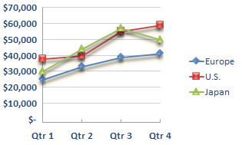
Charts & Graphs (4/6)
Line charts
Line charts can display continuous data over time, set against a common scale, and are therefore ideal for showing trends in data at equal intervals. In a line chart, category data is distributed evenly along the horizontal axis, and all value data is distributed evenly along the vertical axis.
You can use line chart if you have a few evenly spaced numerical labels, especially years. If you have more than ten numerical labels, use a scatter chart instead.

Slide 28
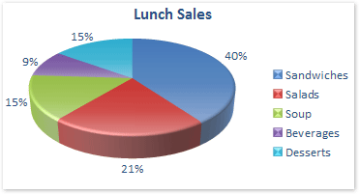
Charts & Graphs (5/6)
Pie charts
Pie charts show the size of items in one data series (data series: Related data points that are plotted in a chart. Each data series in a chart has a unique color or pattern and is represented in the chart legend. You can plot one or more data series in a chart. Pie charts have only one data series.), proportional to the sum of the items. You only have one data series that you want to plot.
None of the values that you want to plot are negative.
Almost none of the values that you want to plot are zero values.
You don't have more than seven categories.
The categories represent parts of the whole pie.

Slide 29
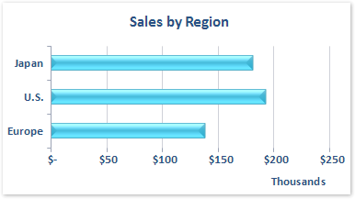
Charts & Graphs (6/6)
Bar charts
Bar charts illustrate comparisons among individual items.
Consider using a bar chart when:
The axis labels are long.
The values that are shown are durations.

Slide 30
Pivot Table Report
A PivotTable report is an interactive table that quickly combines and compares large amount of data. You can rotate its rows and columns to see different summaries of the source data, and you can display the details for areas of interest.

Slide 31
Steps to create PivotTable Report
Insert→ PivotTable Report (Wizard)
Step 1: Specify the data source (whether Excel list / database / external data)
Step 2:Specify the range of data (input)
Step 3: Specify the location (cell range / new worksheet) where you would like to put the pivot table.

Slide 32
PivotTable Report (contd…)
Choose the fields to add to the report
Drag and drop the fields between the areas
Pivot table appears as and when the fields are updated
Pivot report needs to be updated as and when the data changes in the table

Slide 33
Data is organized in PivotTable Report
In a PivotTable report, each column or field in your source data becomes a PivotTable Field that summarizes multiple rows of information.
To create a PivotTable report, you run the PivotTable and PivotChart Wizard.
After you create a PivotTable report, you can customize it to focus on the information you want: change the layout, change the format, or drill down to display more detailed data.

Slide 34
Print an Excel Data
Excel data can be printed by using Print Option in Office Button

Slide 35

Thank You

